Slide 1

Med Interaction checking Template integration
Client Innovation Submission 2014
Notes:
[Introduction] My name is ___ and this is ____ and we are with NextCare.

Slide 2
Who We Are
Urgent Care Specialty
Multiple-practice organization, headquartered in Arizona
8 Brands. 11 states. Over 100 clinics nationwide.
Headquartered in Mesa Arizona, NextCare Holdings is one of the nation’s largest privately-owned providers of urgent care and occupational medicine services.
Brands include: Access Medical Centers (OK), Central Texas Urgent Care (Waco TX), College Drive Urgent Care (WY), Emergent Care Plus (KS/MO), Impact Urgent Care (San Antonio TX), NextCare Urgent Care (AZ, CO, NC, NM, Austin & Houston TX), OhioHealth Urgent Care (OH) and PrimaCare Medical Centers (Dallas TX).
www.nextcare.com
Notes:
[BE BRIEF! This is just our background, and is not essential to the solution.]

Slide 3
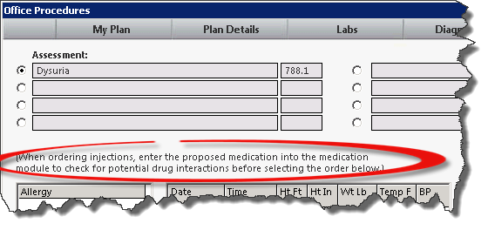
Our Problem
Efficiency
Why spend time doing something that can be automated?
Notes:
1) Our the problem? A very unassuming text on the office procedures that tells us interaction checking requires us to document into the medication module too!

Slide 4
Our Solution
NextGen Template Editor – Existing Trigger
Works on any version with the Patient Medication trigger.
The Innovation
A configurable practice level template.
A few triggers to be added to any place order button.
Notes:
Our goal was to eliminate the need for the additional step of entering the medication in the medication module without having to publish trigger changes for any medication changes.
As well, we wanted a customization that could be carried forward to new KBMs.
1) Our solution using an existing trigger: patient medication – prescribe
2) With just a few triggers, we can cross reference a med order and call the interaction checking…with no additional clicks.
------------------------------------------
Now let’s see this in action…

Slide 5
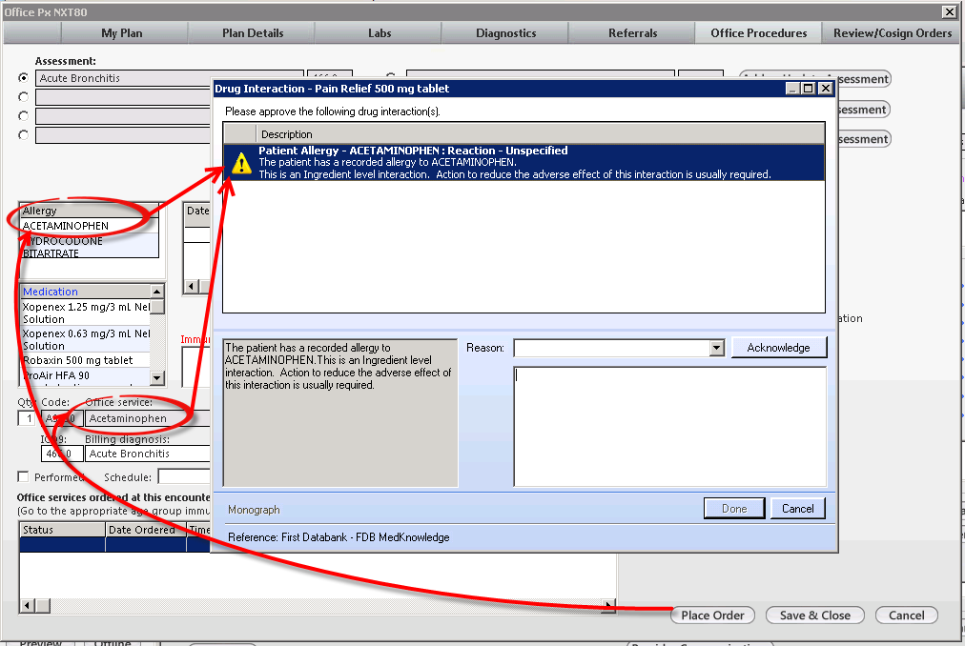
Demo
Notes:
We are currently using this in 5.8 on KBM 8.0, but we’ve also imported the feature to KBM 8.3.

Slide 6
Caveats
Canceling the Medication
Medication Updates
NDC #s changed or removed
New Picklist / DBPicklist Items
No trigger changes, just it to the practice configuration
Monitor with a report or other systematic process
Notes:
This is what we’ve learned through a couple years of use:
1) Canceling the Medication
- If the configuration option is set to have a medication added to the chart, and the interaction results in the medication order being canceled, the medication would need to be manually removed from the module.
2) Medication Updates
- NDCs change frequently, you’ll want to manage this *until* NG wants to integrate.

Slide 7

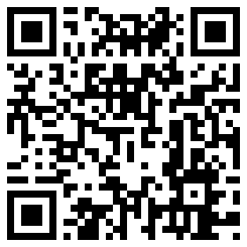
Questions
Kevin Foster
kevinfoster@nextcare.com
Drew Richards
drewrichards@nextcare.com
Templates:
https://github.com/kevinfosterNG/med-interaction
Notes:
----------------------------------
Thank you for your attention
[[Initial timing: 2:15 w/o Demo]]

